Slide 1


PT or PT? Physical Therapy vs Personal Training
Jonathan Cheung
Project 3 (Subreddits)

Slide 2
Agenda
Overview: Physical Therapy and Personal Training
Work Flow – Data retrieval/cleaning, preprocessing, modeling
Modeling
Conclusion

Slide 3

Physical Therapy
Physical therapists (PTs) are movement experts who optimize quality of life through prescribed exercise, hands-on care, and patient education.
3-year doctorate program

Slide 4

Personal Training
An individual certified to have a varying degree of knowledge of general fitness involved in exercise prescription and instruction.
Highschool Diploma / GED and a 3-month certification program

Slide 5
Workflow: Data retrieval, cleaning, preprocessing
Retrieved posts from the past 250 days
3,247 total documents:
2,002 for Phys. Therapy
Filtered for self posts only
Mapped numerical values to classes:
0 for Personal Training
Filtered out ‘[deleted]’ and ‘[removed]’
Concatenated title and selftext features
1 for Physical Therapy
1,245 for Personal training

Slide 6
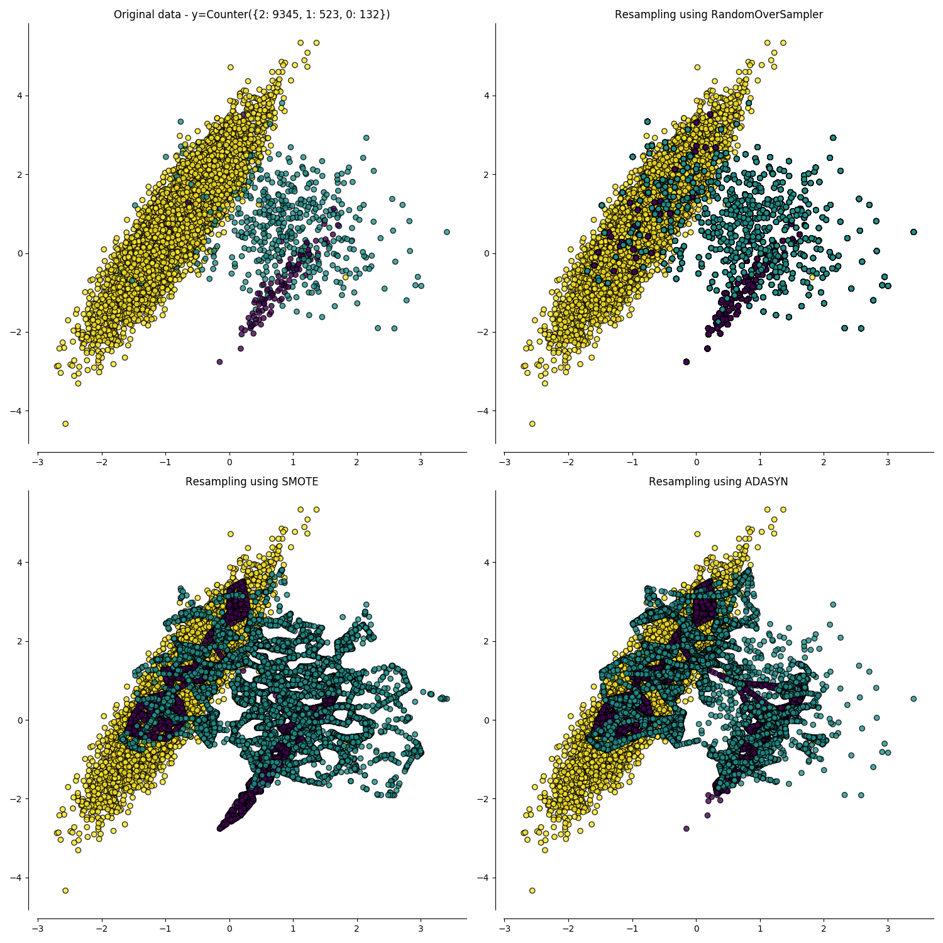
Handling imbalanced classes
65% of data Class 1; 35% Class 0
Random Oversampling (my pick)
SMOTE (Synthetic Minority Oversampling Technique)
ADASYN (Adaptive Synthetic Sampling)

Slide 7
Modeling
LemmaTokenizer that filtered non-alphanumeric characters and English stop words
Two main models:
CountVectorizer with Logistic Regression (L1 penalty)
N-gram range
Max features
CountVectorizer with Multinomial Naïve Bayes
N-gram range
Max features
Alpha (smoothing)

Slide 8
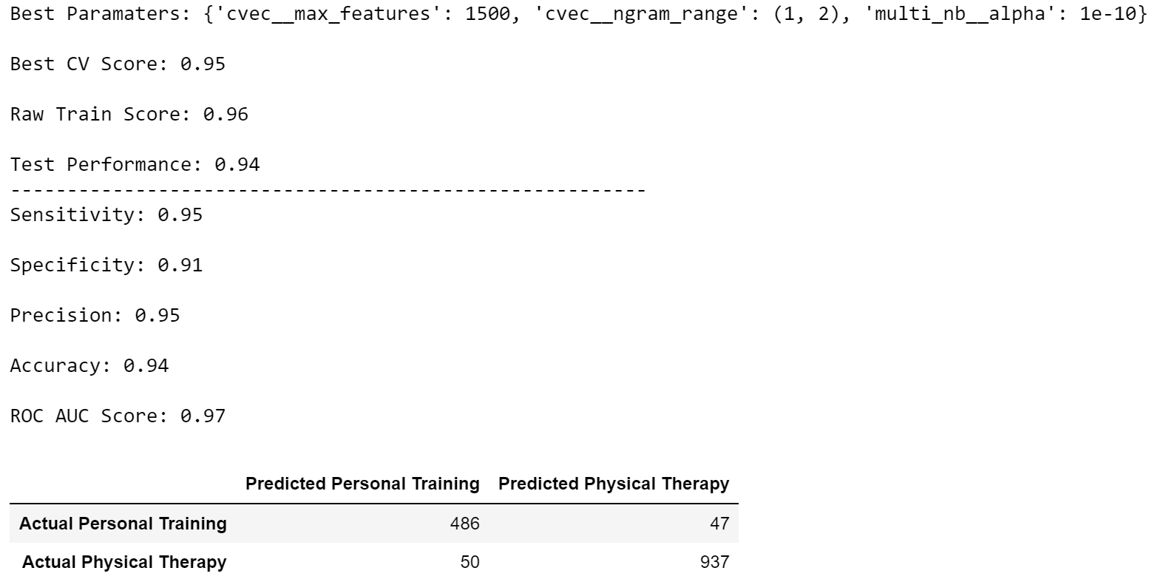
Results
Multinomial Naïve Bayes

Slide 9
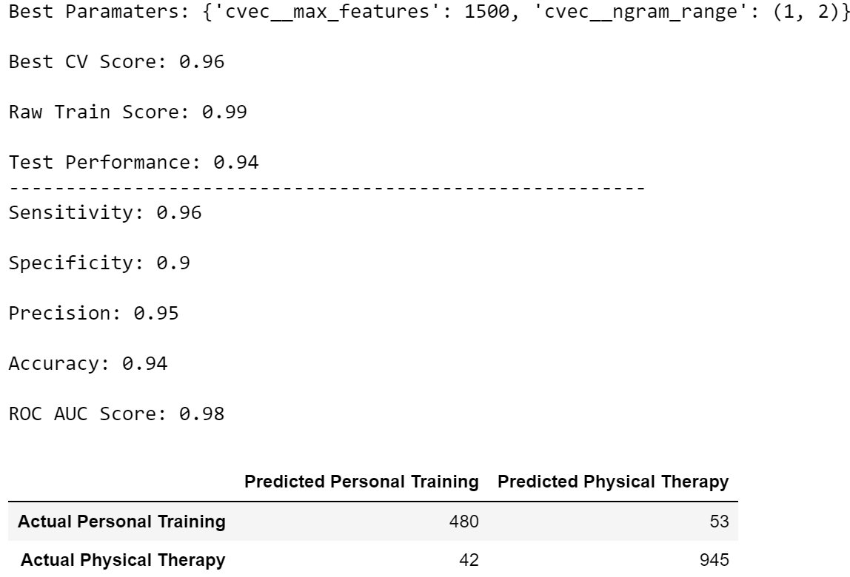
Results
Logistic Regression

Slide 10
Conclusion
Across several different models, these words held most influence:
Top 5 Physical Therapy Words: ['dpt', 'patient', 'physical', 'therapist', 'weak’]
Top 5 Personal Training Words: ['client', 'fitness', 'nasm', 'trainer', 'training']

